Slide 1
UltraSonic Sensor Eyes
Joshua Gray, Briana Murdock, Michael O’Neal and Harrison Smith
Instructor: Hau Fung Moy Kwan
Notes:
All, introductions

Slide 2
Table of Contents
Introduction
Problem
Requirement and Parameters
Design and Operation
Final Project
Applications
Conclusion
References
Notes:
Trevor

Slide 3
Introduction
With any interactive technology, there must be some system that allows detection of surrounding objects, individuals, or obstacles.
Some examples of this might be the X-box Kinect or PlayStation VR where the individual becomes the controller.
Notes:
Trevor

Slide 4
Problem
The problem we attempt to overcome here is that an input needs to be read in from the outside world or surrounding area.
In our case, the task is simply to focus on a particular object in the surrounding area.
Notes:
Harrison/Trevor

Slide 5
Requirement and Parameters
2 Ultra Sonic Sensors, 1 Photo Resistor
2 Max7219 Maxim Integrated 8x8 LED Dot Matrix Display
Jumper wires, 1 Solderless Breadboard,1 Enclosure (ex: cardboard box)
Notes:
Harrison/Josh

Slide 6
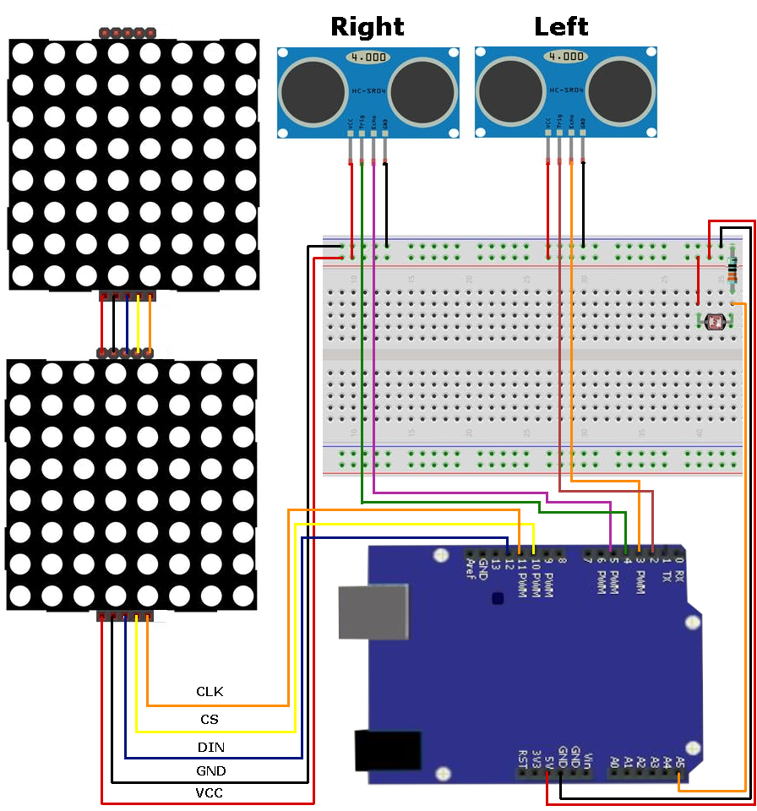
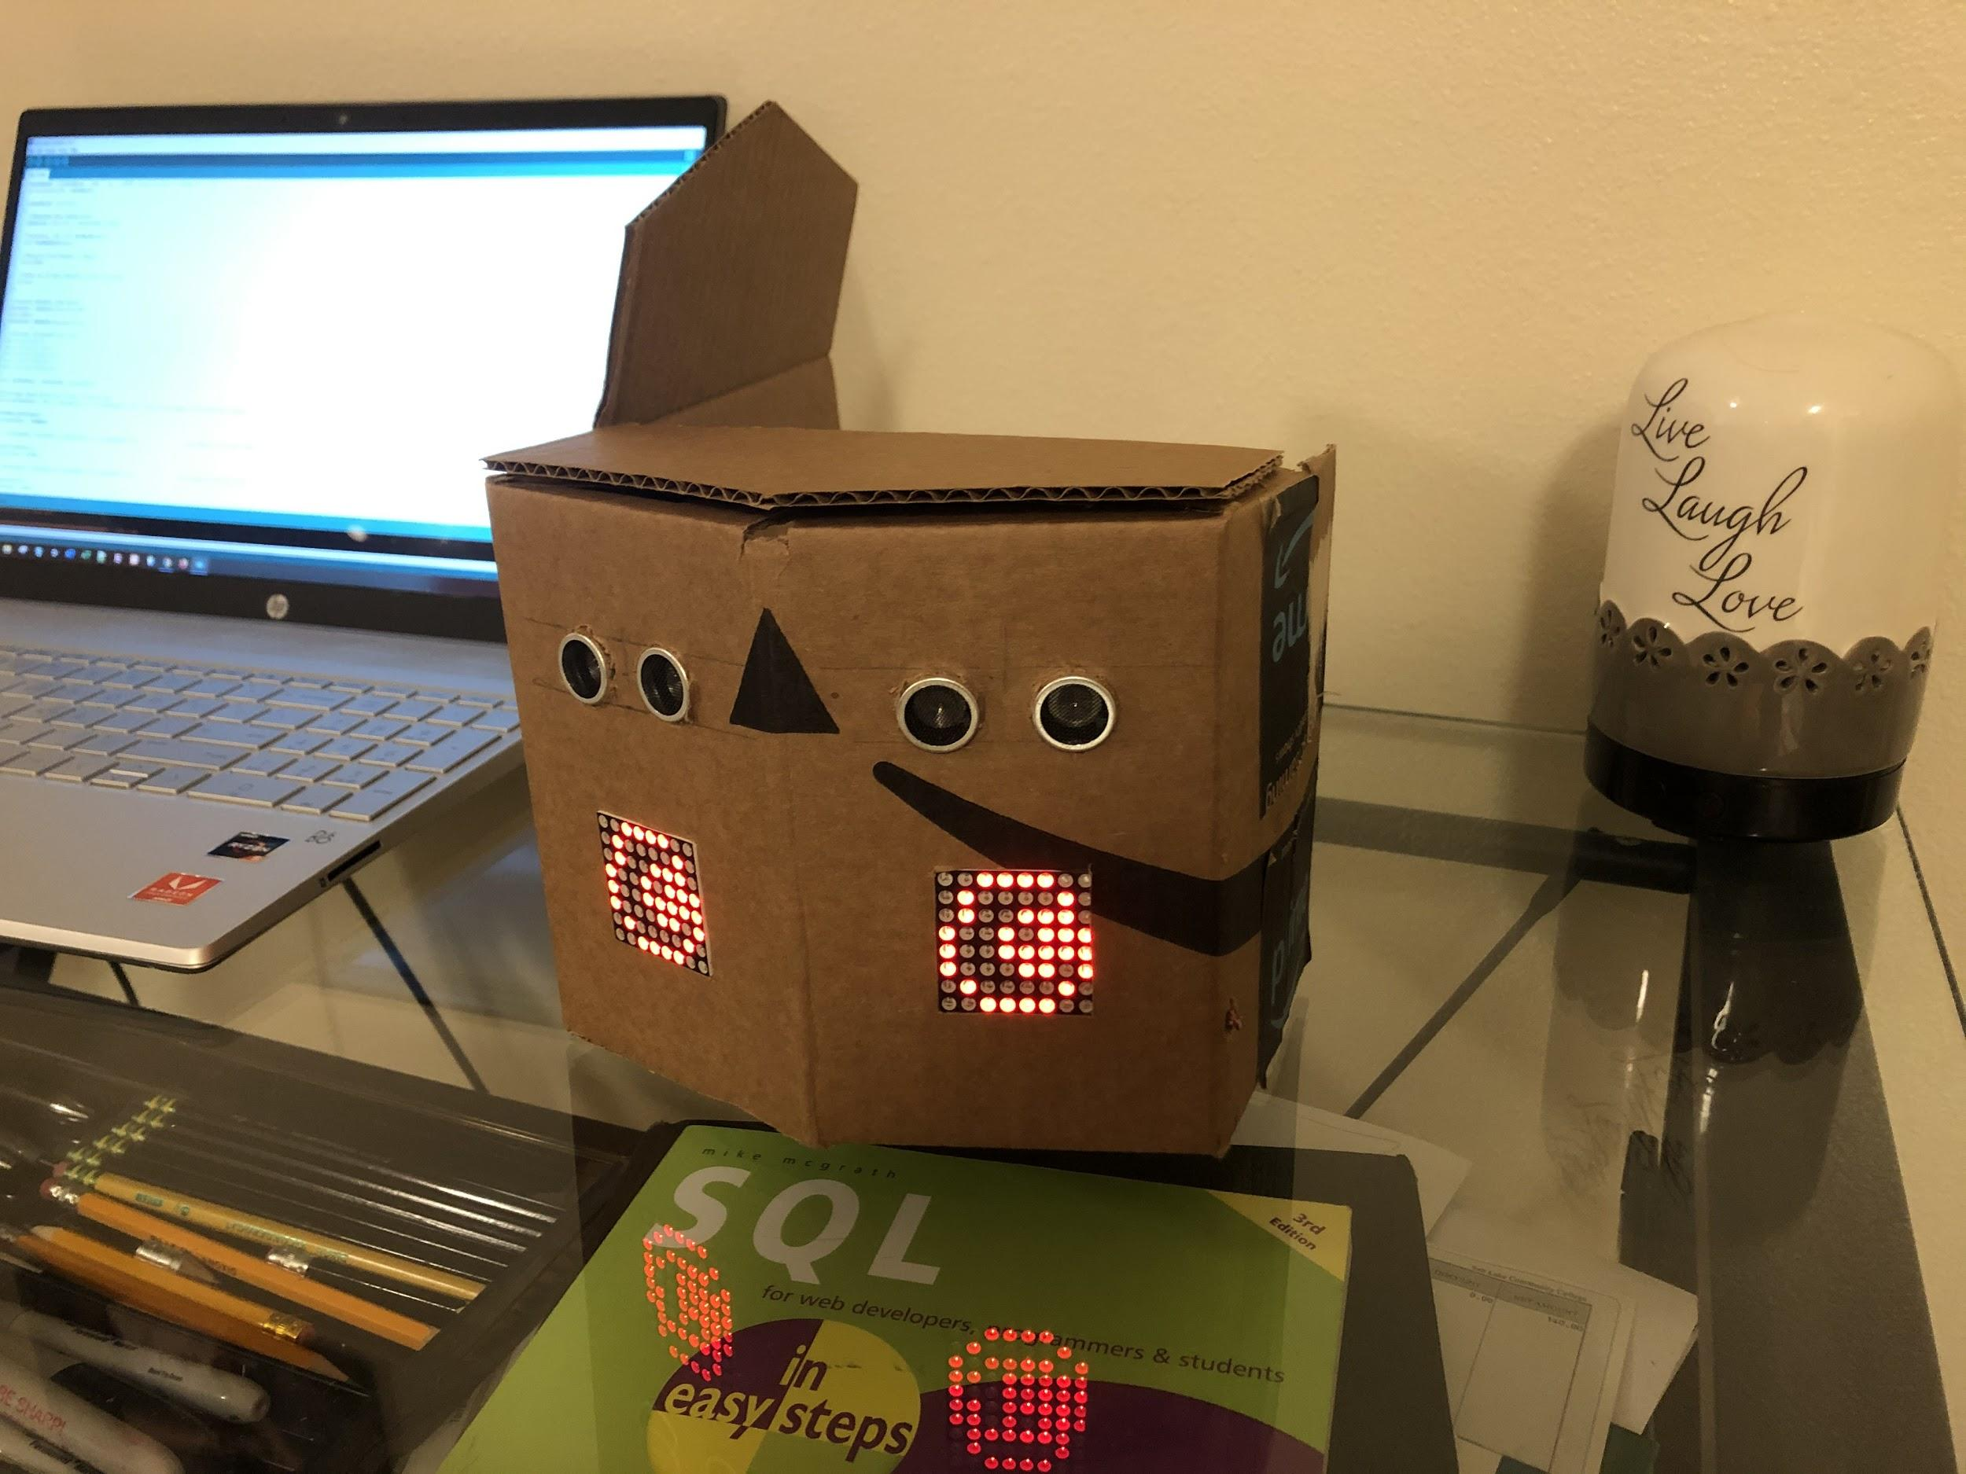
Design and Operation
Uses eye sensors to indicate
sounds are detected.
Eyes remain centered when sounds
are not being detected.
//Code to detect ultrasonic sound waves
//Captures distance from sensors
distanceL = sensorL.ping_median(5);
delay(250);
distanceR = sensorR.ping_median(5);
float difference = (distanceR - distanceL);
Notes:
Josh

Slide 7
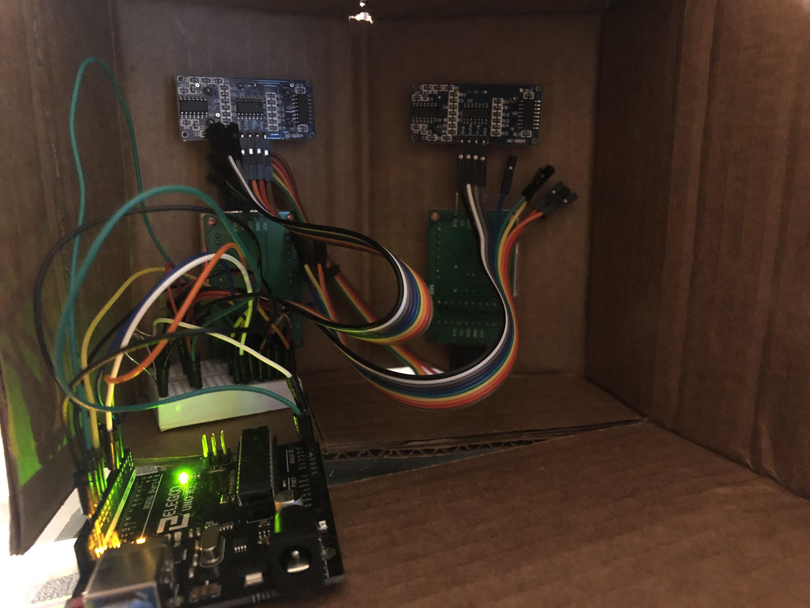
Final Project
Notes:
Josh

Slide 8
Applications
VR, Xbox Kinect, Toys for kids and infants
Home Security- detect specific wavelengths to eliminate wind noise
Roomba, Lights on/off- clapping, Alexa
Remote controls
Ring Doorbell
Notes:
Briana

Slide 9
Conclusion
Ultrasonic sensors have limited detection- the sound needed to bounce off a surface, such as walls or counter tops.
Using a different sensor could expand those limitations.
We could continue to implement this hardware using sound if a sensor was used that works on a large variety of surfaces.
Notes:
Briana

Slide 10
References
Brookshire, Bethany & Raloff, Janet. “Explainer: How the Ears Work.” Science News for Students, https://www.sciencenewsforstudents.org/article/explainer-how-ears-work#:~:text=The%20outer%20ear's%20shape%20helps,tube%20called%20the%20ear%20canal. Accessed 24 November 2020.
Seon. Ultrasonic Eyes. Project hub. https://create.arduino.cc/projecthub/unexpectedmaker/ultrasoniceyes-b9fd38?ref=tag&ref_id=microcontroller&offset=3 Accessed 24 November 2020.
Namphibian. Distance Sensor - Not Working on Fabric Surface. Stack Exchange. https://arduino.stackexchange.com/questions/15943/distance-sensor-not-working-on-fabric-surface Accessed 24 November 2020.
Notes:
Briana

